Slide 1
A core Course on Modeling
Introduction to Modeling
0LAB0 0LBB0 0LCB0 0LDB0
c.w.a.m.v.overveld@tue.nl
v.a.j.borghuis@tue.nl
S.31

Slide 2
Reflection: iterate
define
formulate
purpose
Right problem?
(problem validation)
conceptualize
identify
entities
choose
relations
Right concepts?
(concepts validation)
formalize
obtain
values
formalize
relations
Right model?
(model verification)
execute
operate
model
obtain
result
Right outcome?
(outcome verification)
Right answer?
(answer verification)
conclude
present
result
interpret
result
Notes:
2

Slide 3
Criteria for modeling
Modeling is an iterative process;
models incrementally improve;
to improve a model,
need to compare 2 versions of a model;
to compare, we need criteria,
we will introduce 8 criteria.
http://cdn.morguefile.com/imageData/public/files/m/mzacha/preview/fldr_2009_12_10/file9191260479678.jpg
Notes:
3
criteria (in Dutch): onderscheidingen (eng): distinctions, compare to the medals or badges or regalia related to military ranks or other forms of distinction.

Slide 4
Criteria for modeling
These criteria are:
genericity: how diverse can the modeled system be?
scalability: ‘how ‘large’ can the modeled system be?
specialization: with how little knowledge can the model be used?
audience: how many users can be served by the model?
convincingness: how plausible are the model assumptions?
dictinctiveness: how accurate/precise are the model results?
surprise: how much can we learn from the model?
impact: how much effect can the model results have?
Notes:
4

Slide 5
Criteria for modeling: genericity
Genericity: to which extent is the approach capable to handle various types of modeled systems / purposes?
Examples:
Dynamical systems: buffers & flows
Process modeling: state charts
Data modeling: statistics
Modeling from scratch: 4 categories
http://www.morguefile.com/archive/display/641113
Notes:
5

Slide 6
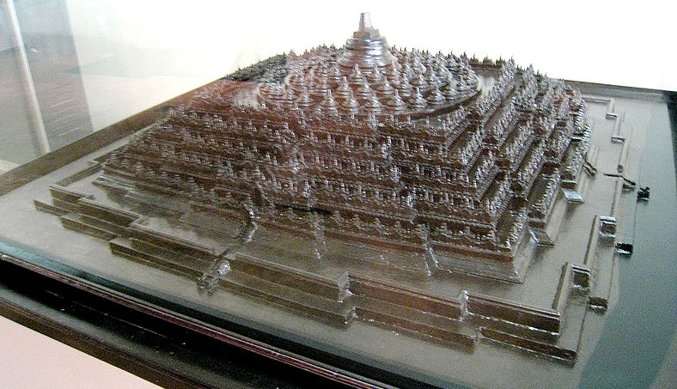
Criteria for modeling: genericity
http://commons.wikimedia.org/wiki/File:Borobudur_Architectural_Model.jpg
Notes:
6

Slide 7
Criteria for modeling: genericity
Genericity: example
Given an object of some shape and density ρ; we want to know its mass.
http://commons.wikimedia.org/wiki/File:Borobudur_Architectural_Model.jpg
Notes:
7

Slide 8
Criteria for modeling: genericity
Genericity: example
Given an object of some shape and density ρ; we want to know its mass.
QUIZ
How do you find the volume of a truncated piramid?
http://commons.wikimedia.org/wiki/File:Borobudur_Architectural_Model.jpg
Notes:
8

Slide 9
Criteria for modeling: genericity
Genericity: example
Given an object of some shape and density ρ; we
want to know its mass.
If it is a cube with side p:
m=ρa³
if it is a
rectangular block with
height h: m=ρ h*Areatop
if it is a truncated pyramid:
m= ρ h*(Areatop + √(Areatop*Areabottom) +Areabottom)/3
Above models are increasingly generic; each deals with the simpler cases as well.
http://commons.wikimedia.org/wiki/File:Borobudur_Architectural_Model.jpg
Notes:
9

Slide 10
Criteria for modeling: scalability
Scalability: to which extent can some characteristic dimensions of the problem increase, where the model still functions?
http://cdn.morguefile.com/imageData/public/files/m/melodi2/preview/fldr_2010_08_03/file2841280826090.jpg
Notes:
10

Slide 11
Criteria for modeling: specialization
Specialization: to which extent does the model / model outcomes requires specialized knowledge on behalf of the problem owner?
http://www.morguefile.com/archive/display/807269
Notes:
11

Slide 12
Criteria for modeling: specialization
Specialization: to which extent does the model / model outcomes requires specialized knowledge on behalf of the problem owner?
Invest in presentation
graph style (line plot, scatterplot, polar plot, barchart, pie chart, 3D surface, …)
labels, captions, scales (zero, lin/log, units, major / minor scale lines …)
how to represent uncertainty?
which plots to combine in a single graph?
http://cdn.morguefile.com/imageData/public/files/h/hotblack/preview/fldr_2008_11_02/file00026290007.jpg
Notes:
12

Slide 13
Criteria for modeling: specialization
Specialization: to which extent does the model / model outcomes requires specialized knowledge on behalf of the problem owner?
When in doubt, be conservative
http://www.morguefile.com/archive/display/60505
Notes:
13

Slide 14
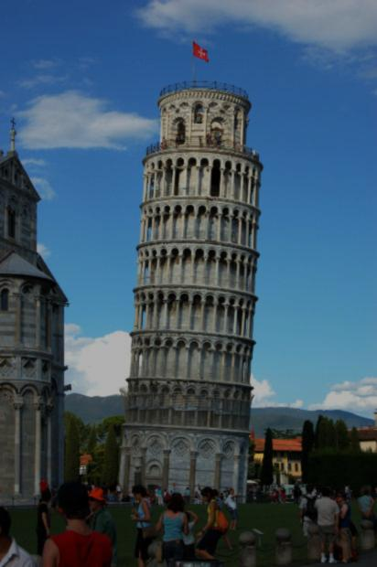
Criteria for modeling: specialization
Specialization: to which extent does the model / model outcomes requires specialized knowledge on behalf of the problem owner?
Be warned for biased users
give a full and detailed account of as much as
possible assumptions and estimates
insist on the report being indivisible
refrain from easy-to-misapprehend results
get a second opinion
http://www.morguefile.com/archive/display/167505
Notes:
14

Slide 15
Criteria for modeling: specialization
Specialization: to which extent does the model / model outcomes requires specialized knowledge on behalf of the problem owner?
Take care for
self-fulfilling and
self-denying
prophecies
http://cdn.morguefile.com/imageData/public/files/k/kevinrosseel/preview/fldr_2008_11_28/file0001317312648.jpg
Notes:
15

Slide 16
Criteria for modeling: audience
Audience: what size of intended
audience does the model address?
Large size: low level of specialization
Large size: no option for
bi-directional communication
Large size: consider interactive
model. Example: ‘stemwijzer ‘
(=recommendation system for voters in democratic elections)
http://cdn.morguefile.com/imageData/public/files/h/hamper/preview/fldr_2008_11_02/file000132185998.jpg
Notes:
16

Slide 17
Criteria for modeling: convincingness
Convincingness: a model is more convincing if it contains fewer and/or less implausible assumptions.
http://cdn.morguefile.com/imageData/public/files/j/jdurham/preview/fldr_2009_06_28/file4701246219194.jpg
Notes:
17

Slide 18
Criteria for modeling: convincingness
Convincingness: a model is more convincing if it contains fewer and/or less implausible assumptions.
QUIZ
Look again at the taxi company model.
Find an example of a very plausible assumption and an example of a very implausible assumption.
http://cdn.morguefile.com/imageData/public/files/j/jdurham/preview/fldr_2009_06_28/file4701246219194.jpg
Notes:
18

Slide 19
Criteria for modeling: distinctiveness
Distinctiveness: a model has higher distinctiveness if it allows distinction between alternatives that are more similar.
Most purposes ask for some form of distinctiveness.
QUIZ
Explain how, for the purposes prediction, explanation and optimization, distinctiveness is crucial.
http://cdn.morguefile.com/imageData/public/files/v/veggiegretz/preview/fldr_2010_11_30/file3551291133107.jpg
Notes:
19

Slide 20
Criteria for modeling: distinctiveness
Distinctiveness: a model has higher distinctiveness if it allows distinction between alternatives that are more similar.
Most purposes ask for some form of distinctiveness.
Examples:
prediction 1: something is correctly predicted to happen at time T₁ rather than T₂; how close can T₁ and T₂ be?
http://cdn.morguefile.com/imageData/public/files/v/veggiegretz/preview/fldr_2010_11_30/file3551291133107.jpg
Notes:
20

Slide 21
Criteria for modeling: distinctiveness
Distinctiveness: a model has higher distinctiveness if it allows distinction between alternatives that are more similar.
Most purposes ask for some form of distinctiveness.
Examples:
explanation: Q₁ causes P₁ and not P₂; Q₂ causes P₂ and not P₁. How close can Q₁ vs. Q₂, or P₁ vs. P₂ be so that the explanation holds?
http://cdn.morguefile.com/imageData/public/files/v/veggiegretz/preview/fldr_2010_11_30/file3551291133107.jpg
Notes:
21

Slide 22
Criteria for modeling: distinctiveness
Distinctiveness: a model has higher distinctiveness if it allows distinction between alternatives that are more similar.
Most purposes ask for some form of distinctiveness.
Examples:
optimization: input P₁ yields output Q₁, and input P₂ yields output Q₂, where Q₁ correctly is found to dominate Q₂. How close can P₁ and P₂ be?
http://cdn.morguefile.com/imageData/public/files/v/veggiegretz/preview/fldr_2010_11_30/file3551291133107.jpg
Notes:
22

Slide 23
Criteria for modeling: distinctiveness
Distinctiveness: a model has higher distinctiveness if it allows distinction between alternatives that are more similar.
Distinctiveness relates to two common types of errors:
false positive (conclude X where there is no X)
false negative (don’t conclude X where there is X)
http://www.morguefile.com/archive/display/560889
Notes:
23

Slide 24
Criteria for modeling: surprise
The potential for surprise of a model outcome is the extent to which it may bring unforeseen new ideas.
There are open and closed spaces of outcomes.
Examples of closed outcomes:
A model computing the probability of X can only produce a number between 0 and 1.
A model verifying Y can only produce ´true´ or ´false´.
http://cdn.morguefile.com/imageData/public/files/e/edouardo/preview/fldr_2009_06_20/file2731245514566.jpg
Notes:
24

Slide 25
Criteria for modeling: surprise
The potential for surprise of a model outcome is the extent to which it may bring unforeseen new ideas.
There are open and closed spaces of outcomes.
Examples of open outcomes:
The result of using ontologies (exploration models)
The outcome of evolutionary algorithms
The outcome of PCA, abstraction, …
http://cdn.morguefile.com/imageData/public/files/e/edouardo/preview/fldr_2009_06_20/file2731245514566.jpg
Notes:
25

Slide 26
Criteria for modeling: impact
The potential for impact of a model is the extent to which the model outcome can affect the stakeholders (either beneficially or adversely).
Two perspectives:
prestige and profit: the more impact the better
risk and responsability: the less impact the better
http://commons.wikimedia.org/wiki/File:First_man_on_the_moon.jpg
Notes:
26

Slide 27
Criteria for modeling: impact
0 ≤ |ρ|≤1: magnitude of impact
If 0 ≤ ρ ≤ 1: positive impact (e.g., models for optimization);
if -1 ≤ ρ ≤ 0 negative impact (e.g., risk prediction or analysis)
The potential for impact of a model is the extent to which the model outcome can affect the stakeholders (either beneficially or adversely).
Intended impact can be capitalized:
r₁=revenues in absence of model outcome;
r₂=revenues with model outcome present;
c₁=cost of ownership in absence of model outcome;
c₂=cost of ownership with model outcome present;
ρ=((r₂-r₁)-(c₂-c₁))/(|r₂-r₁|+|c₂-c₁|)
http://commons.wikimedia.org/wiki/File:First_man_on_the_moon.jpg
Notes:
27

Slide 28
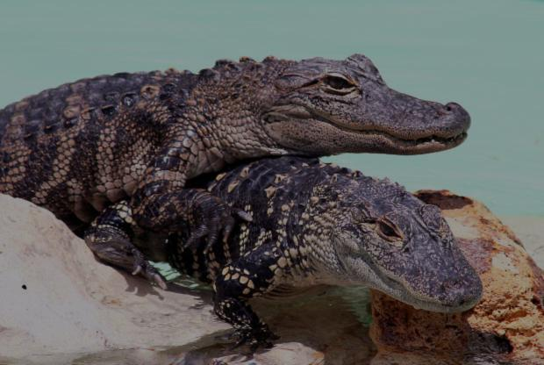
Criteria for modeling: impact
The potential for impact of a model is the extent to which the model outcome can affect the stakeholders (either beneficially or adversely).
Adverted impact can also be quantified or capitalized:
QUIZ
How would you take risk into account in the formula for impact?
http://cdn.morguefile.com/imageData/public/files/c/clarita/preview/fldr_2005_06_05/file0001342292284.jpg
Notes:
28

Slide 29
Criteria for modeling: impact
The potential for impact of a model is the extent to which the model outcome can affect the stakeholders (either beneficially or adversely).
Adverted impact can also be quantified or capitalized:
C=the estimated chance (per time interval) of an incident (=an erroneous model outcome, e.g. a type-I or type-II error)
V=the estimated value loss per incident
Both C and V can serve to quantify the negative impact of a model. Their product CV has dimension of money / time and can be added to c₂ in the formula for ρ.
http://cdn.morguefile.com/imageData/public/files/c/clarita/preview/fldr_2005_06_05/file0001342292284.jpg
Notes:
29

Slide 30
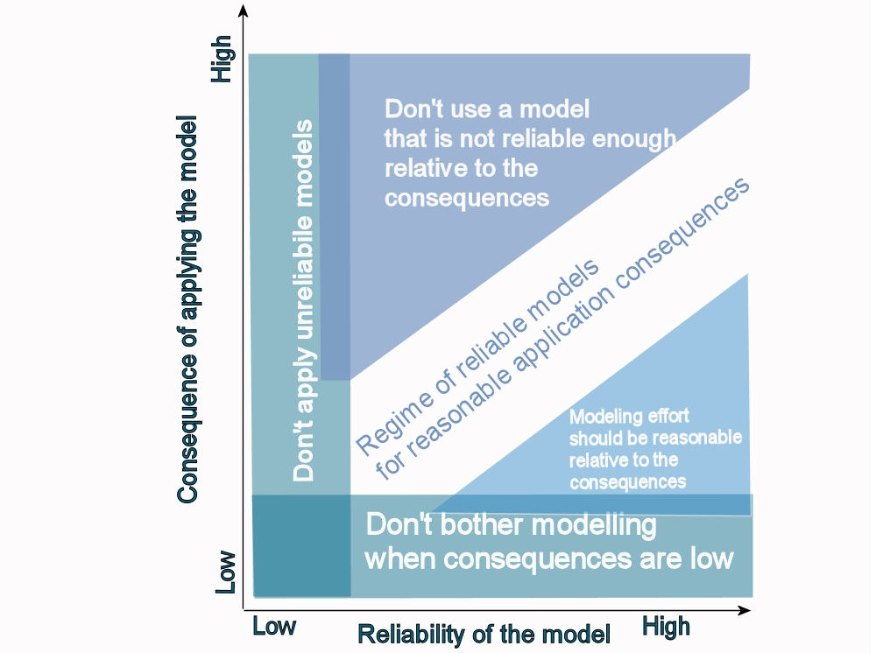
Criteria for modeling: impact
The potential for impact of a model is the extent to which the model outcome can affect the stakeholders (either beneficially or adversely).
The impact of a model should
balance with its reliability.
Notes:
30

Slide 31
Criteria for modeling: a structure on the criteria
QUIZ
You have now seen 8 criteria.
Can you think of a logical structure to group them?
Notes:
31

Slide 32
Criteria for modeling: a structure on the criteria
Property 1:
Does the criterion regard the begin (definition stage of the modeling process) or the end (conclusion stage)?
http://commons.wikimedia.org/wiki/File:Checkered_flags-fr.svg
Example of criterion related to definition: what is the scale of the problem? (scalability)
Example of criterion related to conclusion: how much depends on it? (impact)
Notes:
32

Slide 33
Criteria for modeling: a structure on the criteria
Property 2:
Does the criterion regard the ‘inside’ (model, modeled system) or the ‘outside’ (stakeholders + context) ?
http://www.morguefile.com/archive/display/540558
Example of criterion related to the inside (modeled system): what is the scale of the problem? (scalability)
Example of criterion related to the outside (stakeholders): how much knowledge do the stakeholders need? (specialization)
Notes:
33

Slide 34
Criteria for modeling: a structure on the criteria
Property 3:
Does the criterion regard qualitative or quantitative aspects ?
http://www.morguefile.com/archive/display/723394
Example of criterion related to quantitative aspect: what is the scale of the problem? (scalability)
Example of criterion related to qualitative aspect: how different can modeled systems be? (genericity)
Notes:
34

Slide 35
Criteria for modeling: a structure on the criteria
Combinations
scalability
define/ conclude
inside / outside
qualitative / quantitative
criterion
define
genericity
audience
define
inside
qualitative
genericity
specialization
define
inside
quantitative
scalability
distinctiveness
define
outside
qualitative
specialization
conclude
convincingness
impact
inside
quantitative
define
outside
quantitative
audience
surprise
qualitative
conclude
inside
qualitative
convincingness
outside
conclude
inside
quantitative
distinctiveness
conclude
outside
qualitative
surprise
conclude
outside
quantitative
impact
Notes:
35

Slide 36
Summary
Leading question: to what extent has the initial problem been solved?
Approach: iteratively improve; use criteria to assess the quality of the modeling process
Taxonomy:
definition or conclusion stage?
inside or outside?
Qualitative or quantitative?
→ 8 criteria
Notes:
36

Slide 37
Summary
Resulting criteria:
genericity: how diverse can the modeled system be?
scalability: ‘how ‘large’ can the modeled system be?
specialization: with how little knowledge can the model be used?
audience: how many users can be served by the model?
convincingness: how plausible are the model assumptions?
dictinctiveness: how accurate/precise are the model results?
surprise: how much can we learn from the model?
impact: how much effect can the model results have?
Notes:
37

